Slide 1

AE COURSE PROJECT​
TEAM 14​
TEAM DETAILS​
SL.NO | NAME | USN
01 | RAJESH KATAGAR | 01FE21BEC257
02 | PRASHANTH ASKI | 01FE21BEC268
03 | SHIVANANDA BIRADARA | 01FE21BEC272
04 | SRUSHTI MAHARAJPET | 01FE21BEC301
Under the guidance of: Prof.Prabhavathi Nissimagoudar

Slide 2
PROJECT TITLE​
​CAN protocol implementation with Verilog.

Slide 3
INTRODUCTION:
Controller Area Network (CAN) is a robust, real-time communication protocol that is designed for efficient and reliable data exchange between microcontrollers and devices in automotive and industrial.
It uses a multi-master bus design, which eliminates the need for a main controller and allows several nodes to send and receive messages concurrently.
Through error detection systems and exact timing limits, CAN enables efficient and predictable communication. This makes it perfect for real-time applications where prompt delivery and data integrity are critical

Slide 4
LITERATURE SURVEY:
SL.NO | PAPER | KEY POINTS
1 | Design and Implementation of IP Core for CAN Protocol | The main focus of this research study is on utilizing Verilog HDL to create and implement an IP core that supports the Controller Area Network (CAN) protocol. The study looks at the design's viability and efficacy for possible use in a variety of settings, emphasizing the benefits of CAN in circumstances requiring dependable communication across several nodes with abundant data accessibility.
2 | FPGA SPARTAN 3A Implementation of message based Arbitration in CAN Protocol. | The paper outlines the implementation of a message-based arbitration system for the CAN protocol, enabling communication between ECUs in automobiles. The design targets FPGA technology, specifically the SPARTAN 3A family, to improve performance and reduce hardware size. Using VHDL for the arbiter's functionality, the design is simulated and synthesized with Modelsim and Xilinx ISE. Results show enhanced speed, hardware optimization, and minimal device utilization, demonstrating the design's efficiency and performance.

Slide 5
LITERATURE SURVEY:
SL.NO | PAPER | KEY POINTS
3 | FPGA BASED CAN PROTOCOL CONTROLLER | The paper details the design of an FPGA-based CAN protocol controller using VHDL. It covers the development, testing, and programming of the FPGA to act as a transceiver. It provides an overview of the CAN protocol's history, standardization, and applications in automotive and industrial automation. The paper outlines steps for creating a working FPGA, including planning, coding, simulation, synthesis, and CAN-bus testing. The conclusion emphasizes the successful design of a versatile and high-quality CAN controller.

Slide 6
SDG 11.2: Provide access to safe, affordable, accessible and sustainable transport systems for all, improving road safety, notably by expanding public transport.
Improving Road Safety: CAN systems can enable features like anti-lock braking systems (ABS), electronic stability control (ESC), and collision avoidance systems, crucial for reducing accidents and improving road safety.
Expanding Public Transport: CAN systems are used in public transport vehicles to enhance efficiency, reliability, and safety. Implementing CAN in public transport can contribute to expanding public transport and improving transport systems' accessibility and sustainability.

Slide 7
Applications of CAN protocol
Initially, CAN protocol was designed to target the communication issue that occurs within the vehicles. But later on, due to the features it offers, it is used in various other fields. The following are the applications of CAN protocol:
Automotive (passenger vehicles, trucks, buses)
Electronic equipment for aviation and navigation
Industrial automation and mechanical control
Elevator and escalators
Building automation
Medical instruments and equipment
Marine, medical, industrial, medical

Slide 8
Market Survey
The demand for embedded systems with CAN communication capabilities is rapidly growing across several industries:
Automotive: Modern vehicles rely heavily on CAN for communication between Engine Control Units (ECUs), airbags, anti-lock braking systems (ABS), and other critical components.
Aerospace: CAN is used in aircraft for data exchange between flight control systems, sensors, and actuators, ensuring safe and efficient operation.
Industrial Control: Industrial automation systems utilize CAN for communication between Programmable Logic Controllers (PLCs), sensors, and actuators in factory machinery and process control applications.
This widespread adoption highlights the crucial role of CAN in modern embedded systems.

Slide 9
Market Survey
Existing Solutions: CAN Controller IPs and Open Source
Currently, there are two primary solutions for implementing CAN communication:
Commercially Available CAN Controller IPs (Intellectual Property): These pre-designed cores offer a quick and convenient way to integrate CAN functionality. However, they often come with limitations:
Cost: Licensing fees for commercial IPs can be expensive, especially for academic projects.
Limited Customization: These IPs may not be easily adaptable to specific project requirements.
Open-Source CAN Implementations: Open-source projects offer freely available Verilog code for CAN controllers. While cost-effective, they might present challenges:
Complexity: Understanding and modifying existing code can be time-consuming, especially for beginners.
Limited Support: Open-source projects may lack dedicated support or documentation.

Slide 10
Market Survey
Project Benefits: Verilog Implementation for CAN
Developing a custom CAN controller in Verilog offers distinct advantages:
Customization: Verilog code allows you to tailor the CAN controller to your specific needs. You can define message formats, data lengths, and functionalities precisely for your project.
Integration: A Verilog implementation integrates seamlessly into your custom hardware design. This allows for tighter control over communication protocols and hardware interactions.

Slide 11
Bus Topology
CAN1
CAN2
CAN BUS
CAN3
CAN4

Slide 12
Features Included
Specifications
Masking Filter
Clock Frequency : 50MHz
Arbitration
Data Transfer rate : 1024Kbps
CRC
Bit-stuffing

Slide 13
Implementation Details
CAN Device | Short ID Filter (Hex) | Short ID Mask (Hex)
CAN1 | 0x2 | 0x7FE
CAN2 | 0x3 | 0x7FF
CAN3 | 0x4 | 0x7FF
CAN4 | 0x1 | 0x7FF
CAN1: Receives packets from CAN2 and CAN3 (Short ID 2 and 3).
CAN2: Receives packets from CAN3 (Short ID 3).
CAN3: Receives packets from CAN4 (Short ID 4).
CAN4: Receives packets from CAN1 (Short ID 1).

Slide 14
Processor
CAN Tran receiver
CAN Bus
Controller
TxD
CAN-H
RxD
Mask Register
Sys Clk
Sys Rst
CAN-L

Slide 15
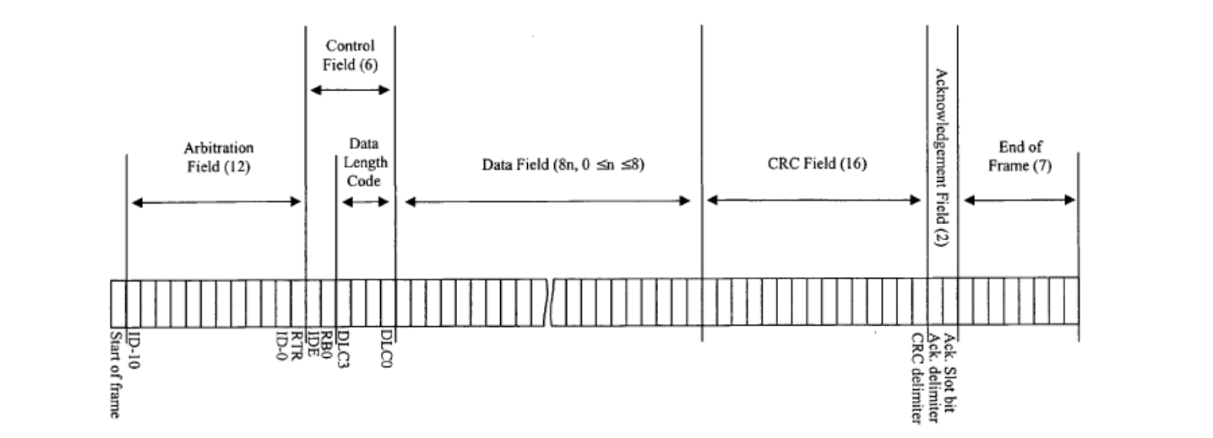

Slide 16
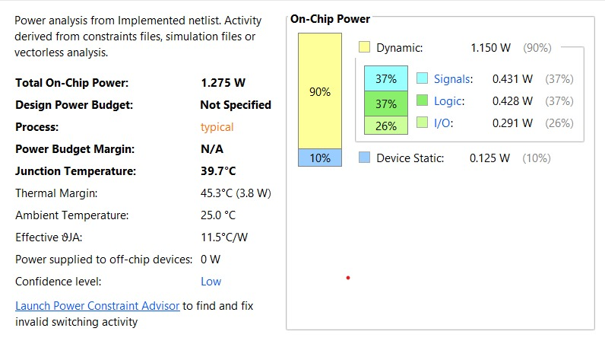
Power Analysis:

Slide 17
Broadcasting
CAN node 1
CAN message
Sending
CAN node 2
CAN message
CAN node 3
CAN message
CAN node 4
CAN message
CAN bus
CAN message
CAN message
CAN message
CAN message
t
CAN node 1
CAN message
CAN message
CAN node 2
CAN message
CAN node 3
CAN message
CAN node 4
CAN message
Receiving

Slide 18
Implementation Details
CAN Device | Short ID Filter (Hex) | Short ID Mask (Hex)
CAN1(80,000) | 0x2 | 0x7FE
CAN2(50,000) | 0x3 | 0x7FF
CAN3(60,000) | 0x4 | 0x7FF
CAN4(50,000) | 0x1 | 0x7FF
CAN1: Receives packets from CAN2 and CAN3 (Short ID 2 and 3).
CAN2: Receives packets from CAN3 (Short ID 3).
CAN3: Receives packets from CAN4 (Short ID 4).
CAN4: Receives packets from CAN1 (Short ID 1).

Slide 19
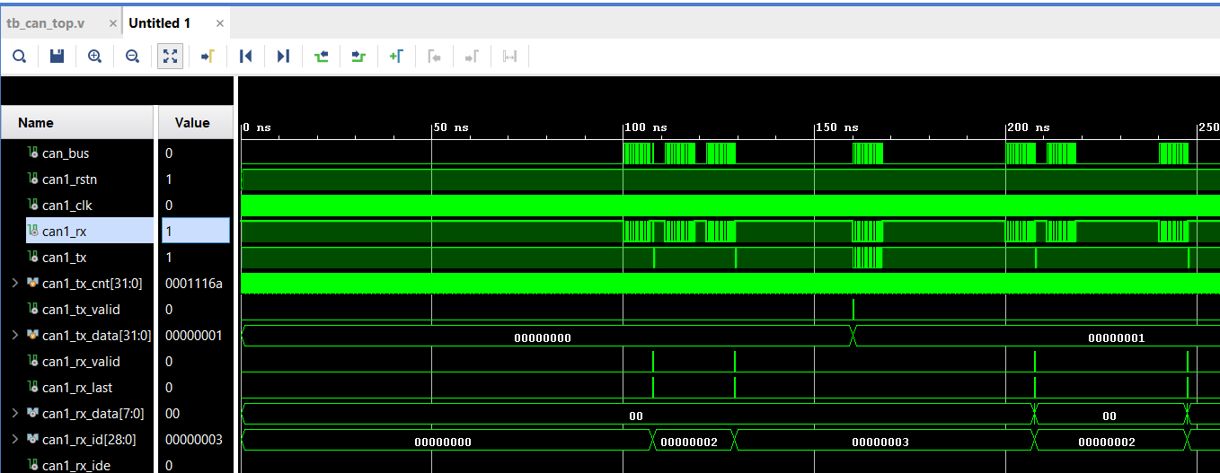
RESULT:

Slide 20
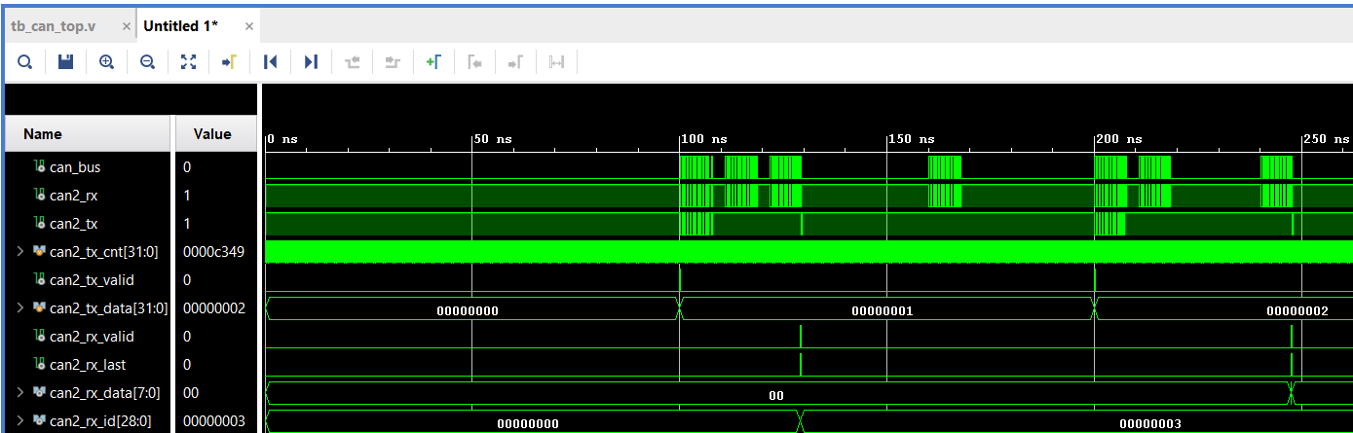
RESULT:

Slide 21
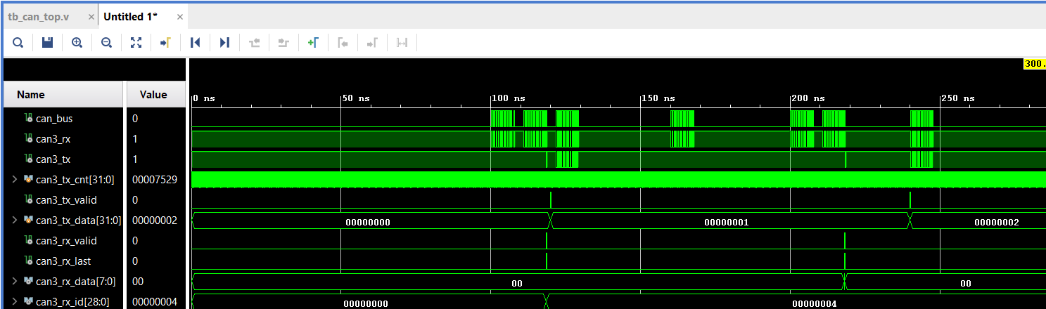
RESULT:

Slide 22
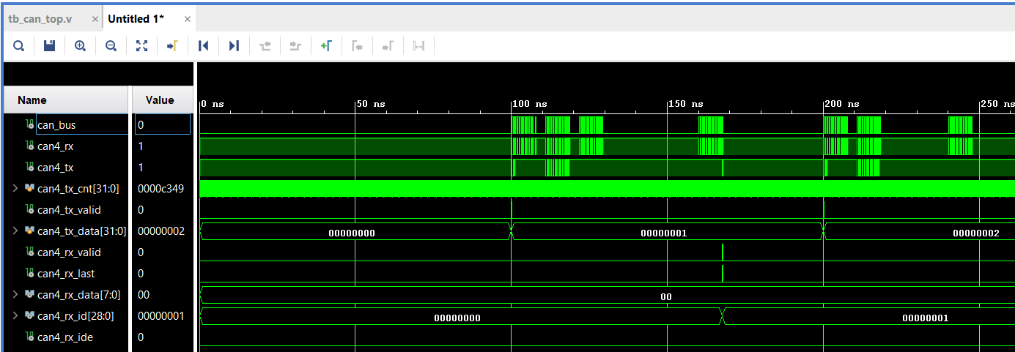
RESULT:

Slide 23
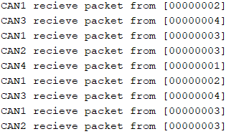

Slide 24
References
Savadatti, M., & Kulkarni, M. Design and Implementation of IP Core for CAN Protocol.
Sharma, Sandeep Kumar, Abhijit Ray, and Yogesh Khandagre. "FPGA SPARTAN 3A Implementation of message based Arbitration in CAN Protocol." (2016).
Hulawale, Tejaswini, Neha Koul, and Shivang Gupta. "FPGA based CAN protocol controller." International Journal of Advanced Technology in Engineering and Science, vol 3.

Slide 25
THANK YOU

